Slide 1
Quality of Coffee
Adam Klaus, Azat Dovgeldiyev, Jackie Prescott, Kris Varothai

Slide 2
Coffee Bean Types
•Arabica
•Most common coffee bean in North America
•Grown mostly in Brazil, with higher elevation levels
•Sweeter, delicate flavor
•More expensive due to environmental factors
•Robusta
•Most common in Europe, Africa, Middle East
•Strong, harsh flavor
•Higher levels of caffeine
•Relatively cheaper due to crop resilience
•Liberica
•Grown mostly in the Philippines
•Fruity, flowery aroma
•Excelsa
•Grown primarily in Southeast Asia
•Tart, fruity flavor
https://districtroasters.com/blogs/news/types-of-coffee-beans#:~:text=There%20are%20four%20primary%20types,dewevrei).

Slide 3
Coffee Qualities
•Flavor
•General taste of the coffee
•Overall perception including all the quality types
•Aroma
•Smell or fragrance
•Indicative of freshness and whether any coffee bean defects are present
•Floral, nutty, fruity
•Body
•Mouthfeel of the viscosity
•Light, medium, full-bodied
•Bitterness/Balance
•Primary coffee flavor sensation
•Arabica is generally less bitter than Robusta
•Acidity
•Quality of the coffee’s acidity
•Sharp, tingly, numbing sensation during the aftertaste
•Sweetness
•Smooth or mildness of the coffee
•Aftertaste
•Experience after you sip the coffee
•Quick, long, lingering, dry, light
https://espressocoffeeguide.com/quality-coffee/

Slide 4
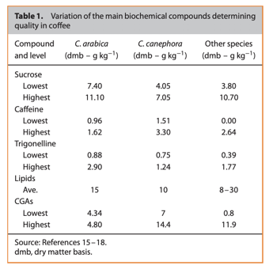
Genomics and Coffee Quality
Researchers looked at the genomes of coffee species to be able to produce higher quality coffee beans with genetic modification to increase yield and enhance overall quality
Genome segments, markers, linked genes, modes of inheritance, and biochemical compounds were identified and discussed
Tran HT, Lee LS, Furtado A, Smyth H, Henry RJ. Advances in genomics for the improvement of quality in coffee. J Sci Food Agric. 2016;96(10):3300-3312. doi:10.1002/jsfa.7692

Slide 5
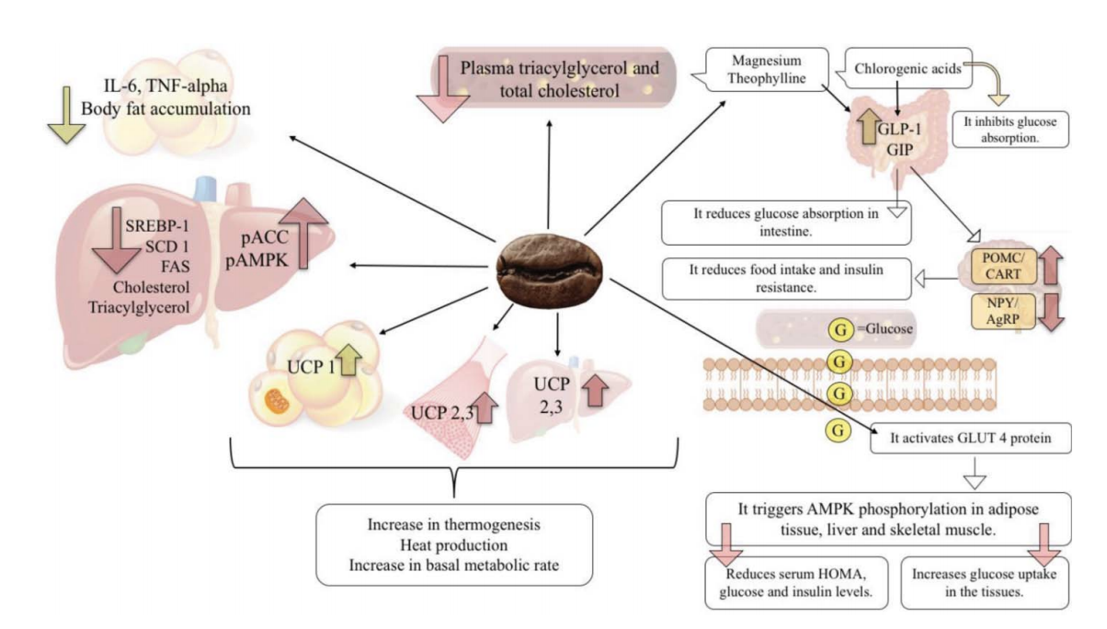
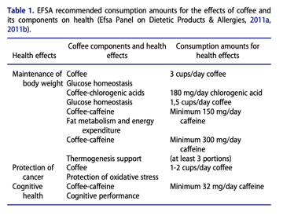
Coffee and Health
Negative correlations have been examined between coffee and…
-Colorectal cancer
-Pancreas cancer
-Liver cancer
-Prostate cancer
-Breast cancer
-Endometrial Cancer
-Oral Cancer
-Parkinson’s Disease
-Type II Diabetes
-Cardiovascular Disease
-Obesity
Büşra Başar Gökcen & Nevin Şanlier (2019) Coffee consumption and disease correlations, Critical Reviews in Food Science and Nutrition, 59:2, 336-348, DOI: 10.1080/10408398.2017.1369391

Slide 6
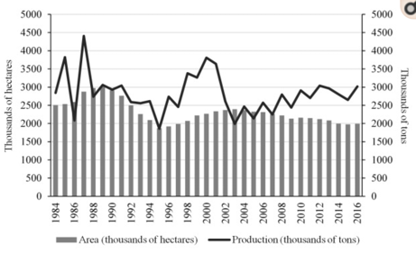
Brazil Economics and Coffee
•Explored the regional and economic changes in coffee production over the years through government regulation and resource availability
•Found that production, planted area, price, and productivity were related
•Used PCA to determine combinations of microregions and production of the two species
Volsi B, Telles TS, Caldarelli CE, Camara MRGD. The dynamics of coffee production in Brazil. PLoS One. 2019;14(7):e0219742. Published 2019 Jul 23. doi:10.1371/journal.pone.0219742

Slide 7
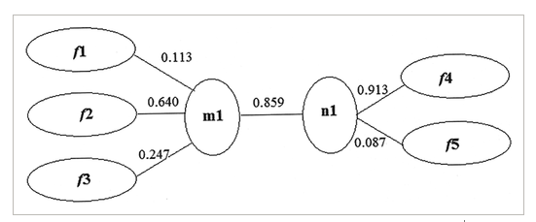
CCA for Mulberries
f1: activity
f2: reduced sugar/crude protein
f3: crude fat and pectin
f4: indices of mineral elements
f5: indices of mineral elements
Sun, R., Sun, L., & Han, C. (2018). Partial-least-squares and canonical-correlation analysis of chemical constituents and active ingredients of new types of Chinese mulberries. Food Science & Nutrition, 6(7), 1950–1959. https://doi.org/10.1002/fsn3.753
Research Question:
  Investigate the association between chemical constituents and active ingredients of different types of Chinese mulberries
Components
  Chemical Components and Mineral Elements
Takeaways
  Reduced sugar and crude fat affected the quality of the mulberries
  Extrapolate how this could be applied to coffee beans

Slide 8
Background of Data
This dataset is derived from the Coffee Quality Institute. The dataset was scraped from the web and converted into tabular data.
21 continuous variables; 22 categorical variables (43 total variables)
1339 rows
Variables can be categorized into 3 categories: Quality Measures; Bean Metadata; Farm Metadata
Missing data was present

Slide 9
Method of Analysis
Test of normality on dependent variable (Cupper Point)
Examine correlation coefficients of dependent and independent variables
Fitting full linear model and check for multicollinearity among independent variables
Split data into train/test at 70/30
Perform stepwise regression using AIC criteria for including and dropping variables
Perform Lasso, Ridge, and Elastic Net regression
Comparison of these four regression techniques.
Note: Total Cup Points variable was not used in regression analysis as it is the sum of variables: aroma, flavor, aftertaste, acidity, body, balance, uniformity, clean.cup, sweetness, and cupper points.
Kris Varothai

Slide 10
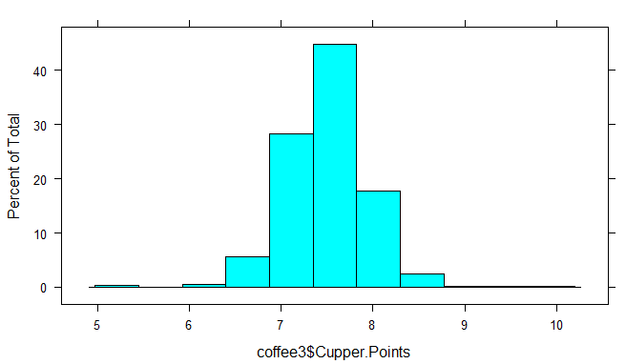
Normality Test via Histogram Visualization

Slide 11
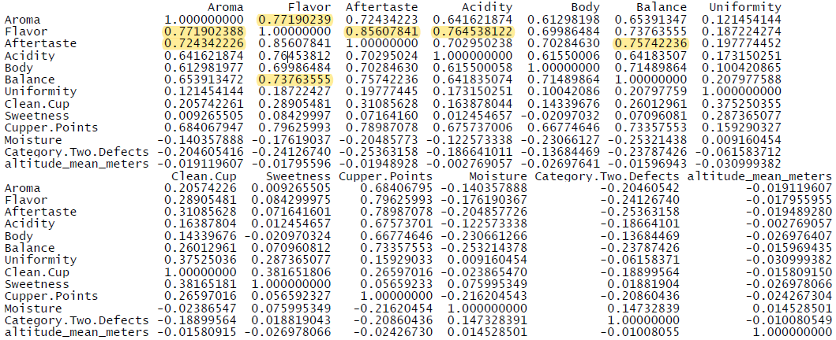
Correlation Examination
Notable correlations are among predictors, highlighted yellow

Slide 12
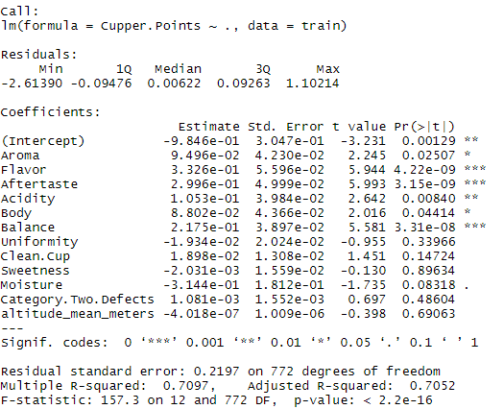

Results from Full Model and VIF

Slide 13
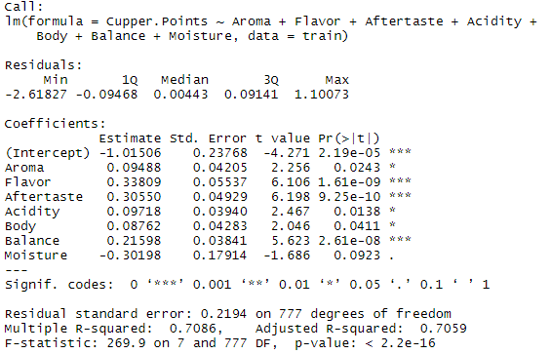
Stepwise Regression using AIC Criteria
0.0007 increase in adj. R-square value and a drastic increase in the F-statistic from 157.3 to 269.9

Slide 14
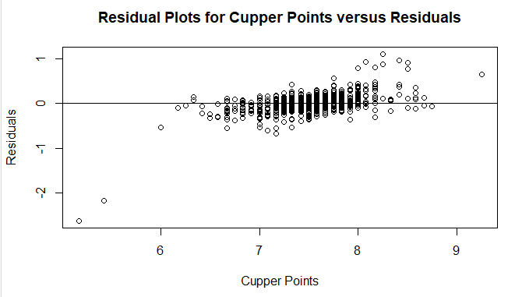
Residual Plot

Slide 15
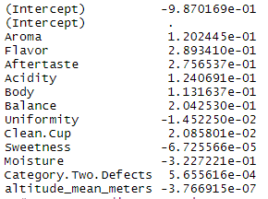
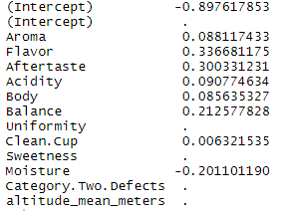
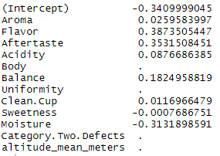
Comparison of Coefficients for Regression
Lasso
Ridge
Elastic Net

Slide 16


Comparison of Model Performance
Stepwise with AIC Criteria
Lasso Regression
Ridge Regression
Elastic Net Regression

Slide 17
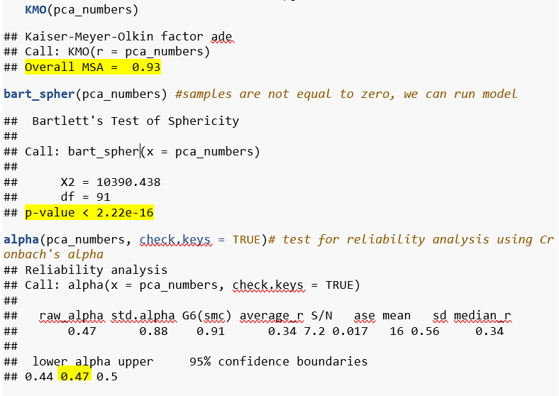
Checking the variance and test for reliability
KMO statistic indicate that the correlations between pairs of variables can be explained by other variables (0.7<)
Bartlett’s test of sphericity suggests there is enough variance to run the model
Cronbach’s alpha was run to test how closely related a set of items

Slide 18
PCA for Coffee Quality
Parallel analysis suggests that the number of factors = 3 and the number of components = 3
Running PCA analysis initially on 3 components, first component (RC1) shows the variables that deals with taste of coffee, we could say that RC1 is taste profile.

Slide 19
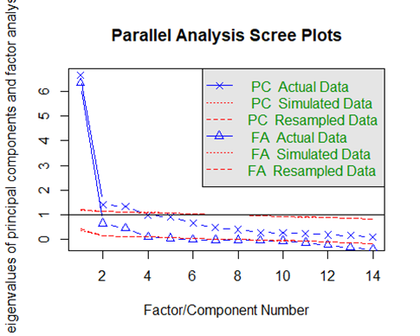
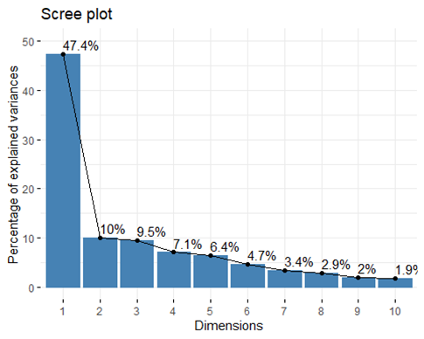
Scree plots
PCA tries to put maximum possible information in the first component.

Slide 20
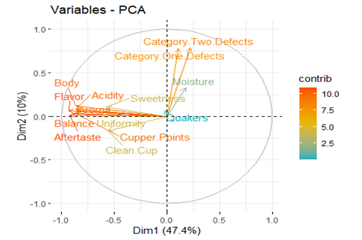
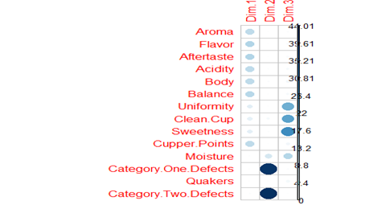
Contributions of each features
Largest circles contribute more on the given components
Aftertaste and Balance have the highest contributions to the Coffee taste grading, Quakers does not have at all

Slide 21
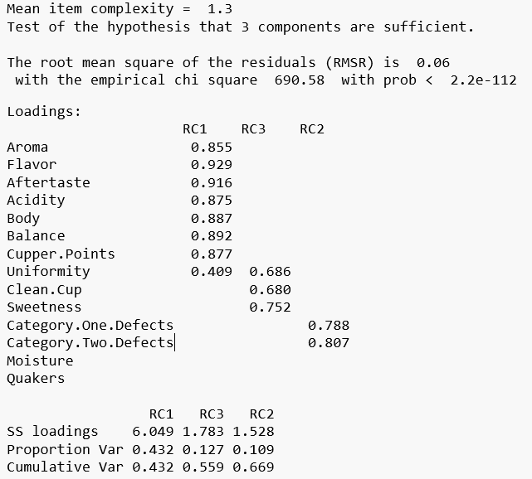
Loadings
Three values are greater than 1. Based on eigenvalues we can use 3 components
Component 1 deals with taste, Component 2 defect classification and Component 3 with cup-to cup differences

Slide 22
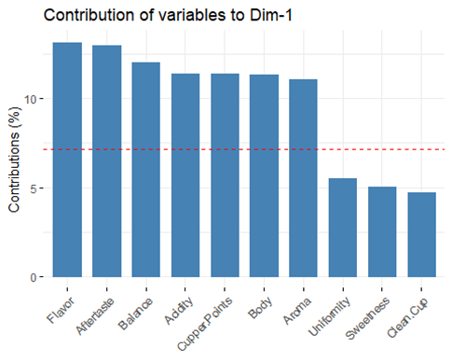
Top 10 features
Table shows features with highest contributions to the Component that deals with taste

Slide 23
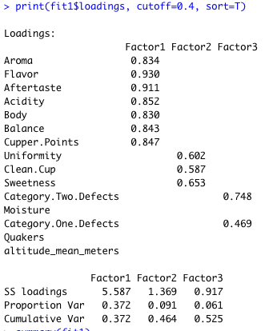
Factor Analysis
Matches results from PCA
Three factors contribute to 52.5% of variance in the data
Factor 1: Taste Factor
Factor 2: Stability Factor
Factor 3: Defects

Slide 24
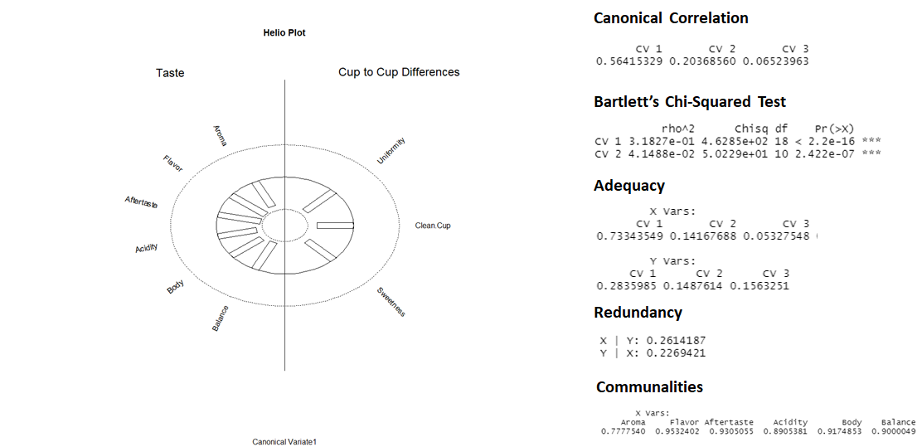
CCA for PCA Components
First Variate (AfterTaste)
Components
  Taste and Cup to Cup Differences
Takeaways
  Most variables have a strong negative influence on the opposing set of variables
  Aftertaste has the strongest influence of any variable in the correlation
  Confirms that taste variables are associated with cup to cup difference variables

Slide 25
Aftertaste Diagnostics

Slide 26
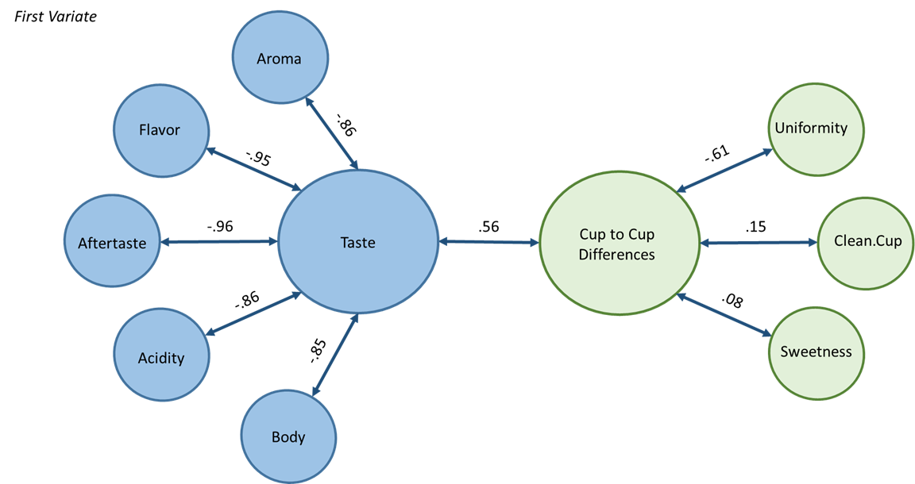
Visualizing Aftertaste Variate

Slide 27
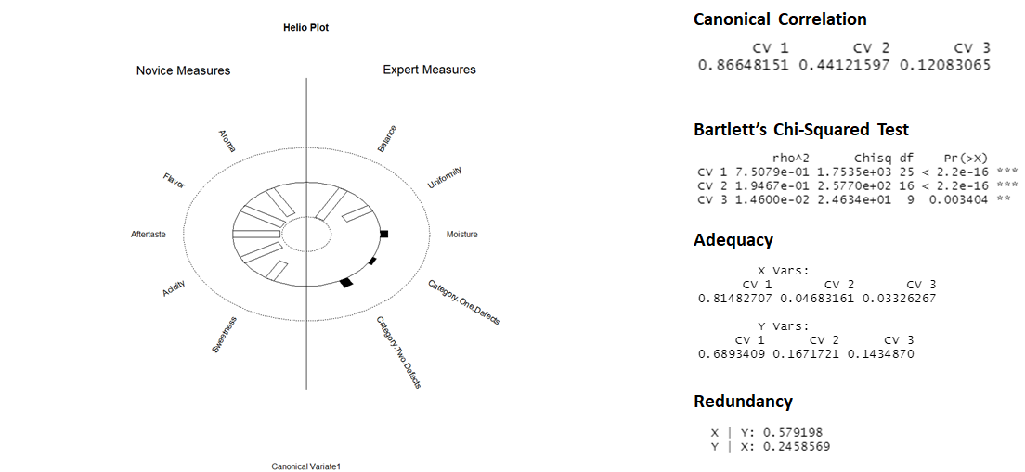
CCA for Quality Measures
First Variate (Balance)
Components
  Novice and Expert Measures
Takeaways
  Most variables have a strong negative influence on the opposing set of variables
  Balance has the strongest influence of any variable in the correlation
  Shows that novice and expert measures of coffee quality are associated with one another

Slide 28
Balance Diagnostics

Slide 29
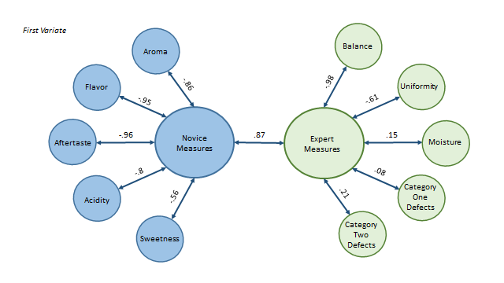
Visualizing Balance Variate

Slide 30
Discussion
Aroma, flavor, aftertaste, acidity, body, balance, and moisture variables represent approximately 70% of the cupper points variance
Component One/Factor One contained the significant variables
Limitations
-missing data was included
-selected tasters were used
-only two coffee bean varieties used
Future Works
-use other coffee bean flavors to determine quality
-modifications to coffee bean genomes to see the effect on health and taste quality

Slide 31
Conclusion
-important variables in determining the quality of coffee was aroma, flavor, aftertaste, acidity, body, balance, and moisture
-defects were omitted from further analysis as they were found to be insignificant in our study
-further research and funds should be directed to quality taste factors rather preventing defects in beans
-higher quality coffee can have a wide range of implications, such as agriculture changes, health benefits, and even improving economies, just by increasing consumption!
- To maximize Cupper.Points is to have high values in flavor and aftertaste and low values in moisture, meaning good coffee taste and flavor with less moistrue in beans.

